Slide 1
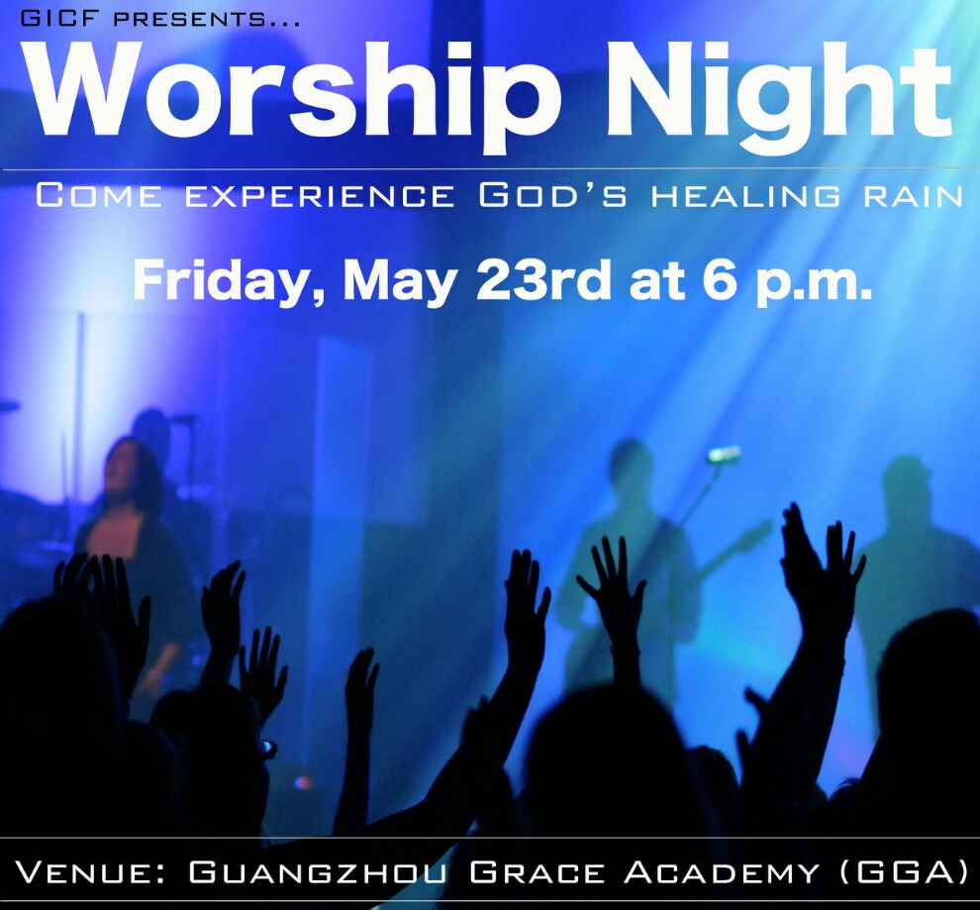

WORSHIP NIGHT
6 pm – 9:30 pm

Slide 2

Choosing the Safe Road
Notes:
Safest road from Your house to church? None?
Safest road from Jerusalem to Jericho? None
What is the safest form of investment? Highest ROI?
Safest road to happiness & fulfilment? You MUST invest your life in something. What is the safe road for investing it? Stay tuned for the answer

Slide 3
  II Timothy 3:10-11
¹⁰ But you have carefully followed my doctrine, manner of life, purpose, faith, longsuffering, love, perseverance, persecutions, afflictions, which happened to me at Antioch, at Iconium, at Lystra—what persecutions I endured. And out of them all the Lord delivered me.

Slide 4
  II Timothy 3:12-13
12 Yes, and all who desire to live godly in Christ Jesus will suffer persecution. But evil men and impostors will grow worse and worse, deceiving and being deceived.
Notes:
Fake Christians are among our most discouraging challenges.

Slide 5
  II Timothy 3:14-15
¹⁴ But you must continue in the things which you have learned and been assured of, knowing from whom you have learned them, ¹⁵ and that from childhood you have known the Holy Scriptures, which are able to make you wise for salvation through faith which is in Christ Jesus. ​​

Slide 6
  I. You know my story
¹⁰ But you have carefully followed my doctrine, manner of life, purpose, faith, longsuffering, love, perseverance, persecutions, afflictions, which happened to me at Antioch, at Iconium, at Lystra—what persecutions I endured. And out of them all the Lord delivered me.
Notes:
Antioch of Psidia (Turkey) persecuted for preaching
My Iconium Story – The Lord delivered me (bus out to Pammukkale)

Slide 7
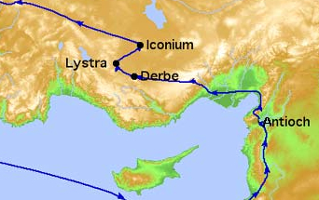
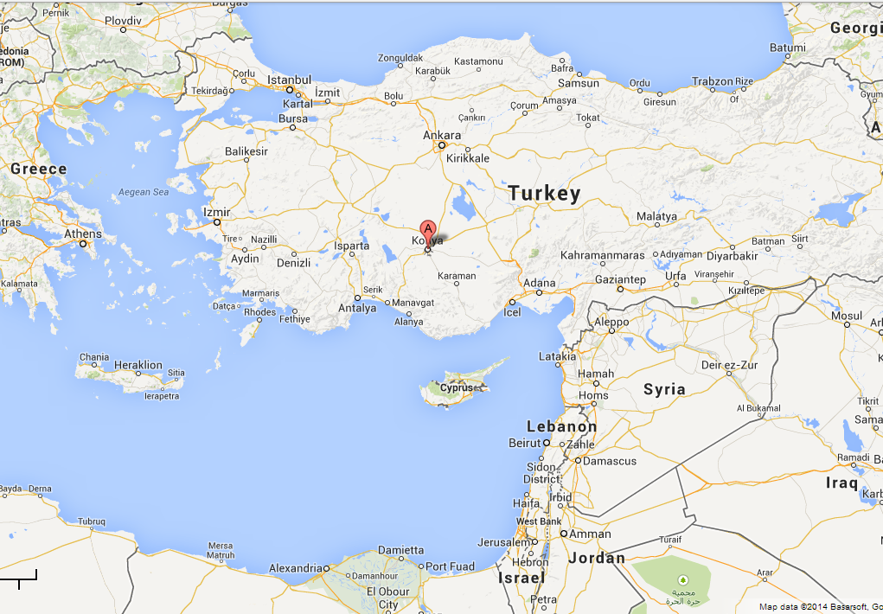
Iconium (Konya, Turkey)

Slide 8
I. You know my story & purpose (Acts 14)
Iconium
Miracles
Divided opinion but united persecution from Jews & Greeks
Violent stoning attempt
Lystra
Timothy’s home area
Lame man healed (‘godhood’ refused)
Paul stoned
Derbe
Many converts
Recharging for return to Lystra & Iconium WHAT? Back there?
Antioch (Syria) – giving praise for what God had done
The Lord delivered me
out of all my persecutions
Notes:
Timothy was well acquainted with this story. This is when he met Paul and was taken on as a disciple/trainee
Timothy had carefully watched and followed Paul’s purpose (v10)

Slide 9
  II. You know the promise
12 Yes, and all who desire to live godly in Christ Jesus will suffer persecution. But evil men and impostors will grow worse and worse, deceiving and being deceived.
Notes:
John 16:33 – promise of persecution
Fake Christians are among our most discouraging challenges.
Fake vs. Timothy (see next verses)

Slide 10
  III. You know the Way (continue in the Word)
¹⁴ But you must continue in the things which you have learned and been assured of, knowing from whom you have learned them, ¹⁵ and that from childhood you have known the Holy Scriptures, which are able to make you wise for salvation through faith which is in Christ Jesus. ​​
Notes:
You know the Way (the road) to success, fulfillment, happiness is to continue in the Word.
We (like Timothy) have the assurance that this is so because:
God’s Word tells us & makes us wise for salvation through faith
God’s Spirit in us enables us to live this way
Paul asks Timothy – You know my story, and the promise of the same for you, so ‘Are you up for it?’

Slide 11
The Challenge
How well do you know the Bible?
Are you living (= investing your life) wisely?
  How can you prove it!
  Others are watching to see your story & purpose
Are you living by faith?
Notes:
II Tim 3:1-9 (next week) speaks of perilous last times & wicked imposters. What is our response?
Discipleship Course (see Eddie)
If you find the cure for cancer you would tell everyone. We have something greater than the cure for cancer!
Living by faith = seeing the eternal as more important and longer lasting than the terrestrial

Slide 12
  Theme for 2014
  GO & MAKE DISCIPLES
What is the safest road to happiness & fulfilment?
Keep in the middle of the road (of God’s will for your life) Isaiah 30:21.
‘Is this road the safest?’ NO! But you are safe in His hands!
The eternal God is your refuge, and underneath are the everlasting arms; Deut 33:27
Notes:
Not

Slide 13
Will you continue in full assurance of the gospel to …
Go and Make Disciples
… knowing the Lord will deliver you out of all persecution…?
Notes:
Nothing else is a safe investment of your life.
What shall it profit a man to gain the whole world and lose his own soul for what shall a man give in exchange for his soul? Mark 8:36

